Slide 1
Preparing for and Responding to Disasters
Celeste Putnam, Technical Expert II
Ann Wing, Technical Expert I
Karen Yost, Technical Expert III
September 10, 2024
This event is supported by the Health Resources and Services Administration (HRSA) of the U.S. Department of Health and Human Services (HHS) as part of an award totaling $10,000,000 with 0% financed with non-governmental sources from the Rural Communities Opioid Response Program (RCORP). The contents of the book(s) being discussed and the views they present are those of the author alone and do not necessarily represent the official views of, nor an endorsement, by JBS, HRSA, HHS, or the U.S. Government. For more information, please visit HRSA.gov.
The following activity may contain content that could be distressing to some participants. Feel free to step away if you need to. For a list of resources and other outlets for support, please visit the RCORP-TA portal here. Also feel free to reach out to your own supports as needed.

Slide 2
Submitting Questions and Comments
Submit questions by using the Q&A feature. To open your Q&A window, click the Q&A icon on the bottom center of your Zoom window.
If you experience any technical issues during the webinar, please message us through the chat feature or email RCORP-TA@jbsinternational.com.
The following activity may contain content that could be distressing to some participants. Feel free to step away if you need to. For a list of resources and other outlets for support, please visit the RCORP-TA portal here. Also feel free to reach out to your own supports as needed.

Slide 3

Introductions and Objectives
Objectives:
Identify the four phases of disaster preparedness
Explain the response recovery continuum.
Describe the psychological and emotional impact of disasters and ways to address them.

Slide 4
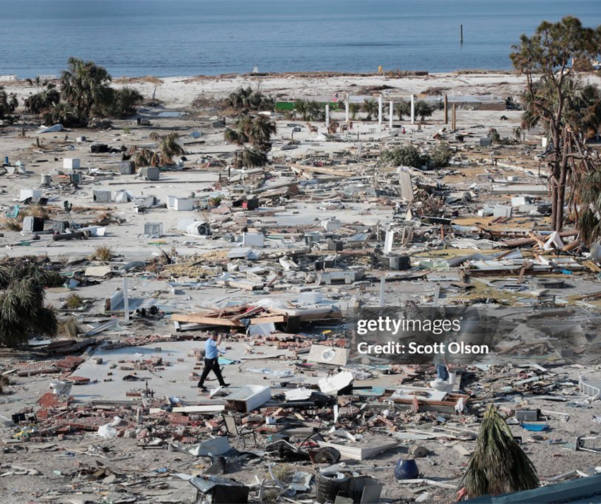
Disaster Poll
Natural and human made disasters
Poll Question:
Who has experienced a disaster?
Aftermath of Hurricane Michael, October 2018
Notes:
The prevalence of disasters CDC:
Approximately 400 natural disaster world wide according to the CDC in 2018
Cost of and degree of disasters are climbing

Slide 5
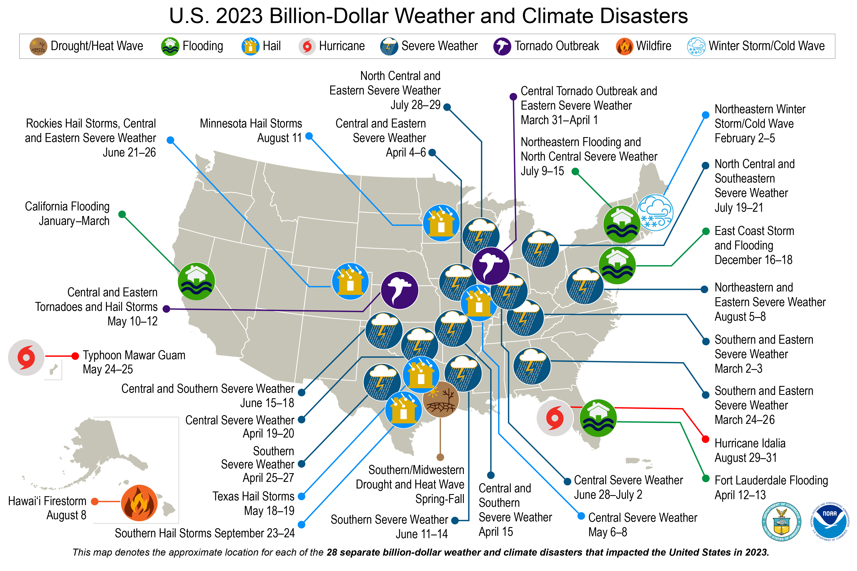
Natural Disaster Data 2023
2023-billion-dollar-disaster-map.png | NOAA Climate.gov
Notes:
2024 is on track to top

Slide 6
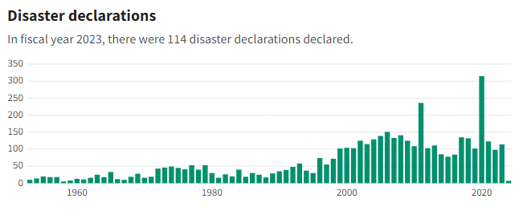
Natural Disaster Data 2023
US Disasters & Emergency Relief Statistics and Data: government spending, disaster declarations, and more | USA Facts
US Disasters & Emergency Relief Statistics & Data: government spending, disaster declarations, and moreIUSA Facts
Notes:
2024 is on track to top

Slide 7
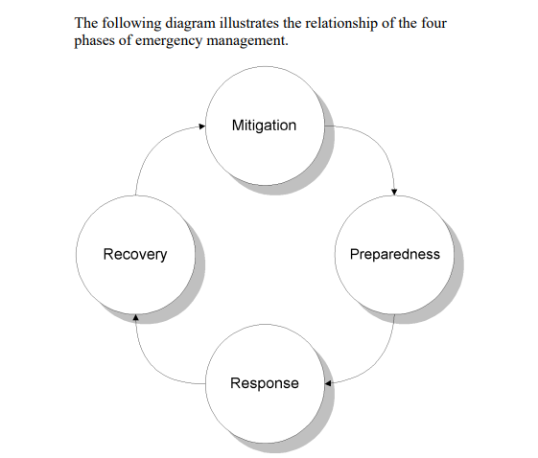
Four Phases of Disaster Preparedness
https://www.fema.gov/emergency-managers/national-preparedness/goal

Slide 8

Pre-Disaster Recovery Planning
Ensures readiness to undertake organized recovery process in a sustainable resilient way
Provides a local-level framework for leading, operating, organizing, and managing resources for post-disaster recovery activities
LEPC (Local Emergency Planning Coalition)
https://www.fema.gov/sites/default/files/2020-07/pre-disaster-recovery-planning-guide-local-governments.pdf
Notes:
With a planning framework in place (developed using this guide), a community is better situated to address pre-existing local needs, take advantage of available resources, and seize opportunities to increase local resiliency, sustainability, and access to resources.

Slide 9
Pre-Disaster Recovery Planning Steps
Form a Collaborative Planning Team
Develop collaborative planning team and scope of planning activities
Develop and implement partner engagement strategy
Understand the Situation
Determine community risks, impacts, and consequences
Determine Goals and Objectives
Assess community’s capacity and identify capability targets
Develop the Plan
Determine leadership positions and define necessary operations
Establish process for post-disaster decision-making and policy setting
Prepare, Review, Approve Plan
Write the local pre-disaster recovery plan
Approve the pre-disaster recovery plan and associated regulations
Implement and Maintain Plan
Identify ongoing preparedness activities
“Pre-Disaster Recovery Planning Guide for Local Governments” FEMA Publication FD 008-03, pg 4

Slide 10
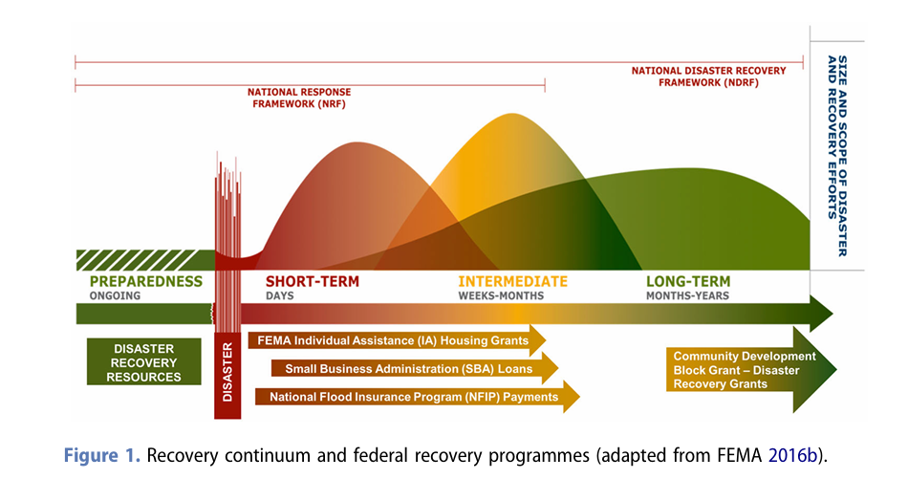
The Response/Recovery Continuum
Notes:
The Response- Recovery Continuum includes three overlapping phases – Short –Term, Intermediate and Long-Term. Each phase has a set of activities that communities typical employ in their response and recovery.

Slide 11

Short-Term Phase
When the disaster strikes the community, state and federal partners implement the disaster plan.
Short-term phase encompasses immediate response and usually last weeks but can go up to months in some situations.
Search and rescue
Emergency response to provide water, food, shelter, medicine and medical care.
Clean up and restore household functioning. Ensure safety.
Establish communication and operational links with emergency response entities.
Assess impact and damage
Notes:
During this phase community members are devastated by the damage. People tell stories of the rescue events. Water and food is delivered and distributed. Shelters that were opened before the storm continue to operate for those that have no place to go. Emergency organizations such as FEMA, Red Cross, and faith-based emergency relief come on the scene.

Slide 12

Intermediate Phase
This phase last weeks to several months.
Local disaster recovery managers communicate with other stakeholders to continue recovery efforts.
Local officials organize grants and financing for public assistance. Households can apply for individual assistance.
Non-government entities provide direct assistance to community members. Disaster Case Management is established. Volunteer groups are organized.
Infrastructure repairs begin-Debris is removed, power and cable lines are repaired, cell towers restored, and roads begin to re-open.
Households struggle with insurance/benefits/demolish or reconstruct options.
Long Term Recovery Community Groups are formed.
Housing is provided to those in need. Examples- FEMA funded RVs – short term rental assistance.
Households find housing- friends/family, rentals out of the region.
Grocery stores and gas stations re-open.
Programs establish temporary locations such as operating out of tents during reconstruction.
Businesses begin to reopen often in temporary sites.
Schools re-open.
Notes:
Rural areas have less resources than urban areas. Housing is a problem. Many people have to move out of the area and due to business closures lose their jobs. Tourist industry is badly hit.

Slide 13
Long-Term Recovery Phase
The phase of recovery can last for several years.
Emphasis changes from temporary assistance to permanent restoration.
Long Term Recovery Groups operate to provide households direct services through grants and volunteers.
Health and social services begin to be re-established. Permanent buildings open.
Restoration of natural and cultural resources.
Households receive individual assistance from local, state and federal sources.
Home reconstruction is underway.
Economic recovery is supported by several federal and state organizations.
Permanent and affordable housing is key to recovery. Assistance is provided by FEMA, DOJ, USDA and HUD.
Infrastructure systems are repaired and improved.

Slide 14
Role of Governmental Entities During Disaster Response
State and Local Governments
Governor
State Emergency Management Agency Director
National Guard
Other State Departments
Tribal/Territorial Insular Areas
Chief Executive for the tribe
Territorial/Insular Area Leaders
https://www.fema.gov/sites/default/files/2020-06/national_disaster_recovery_framework_2nd.pdf

Slide 15
Role of Governmental Entities During Disaster Response
Federal Government
Secretary of Homeland Security
FEMA Administrator
Attorney General
Secretary of Defense
Secretary of State
Director of National Intelligence
https://www.fema.gov/sites/default/files/2020-06/national_disaster_recovery_framework_2nd.pdf

Slide 16

Role of Non-Governmental Agencies (NGOs)
Provide Immediate Relief
Preparedness and Risk Reduction
Coordination and Collaboration
Advocacy and Policy Influence
Empowerment and Rehabilitation
Pre-Disaster Recovery Planning Guide for Local Governments (fema.gov)

Slide 17
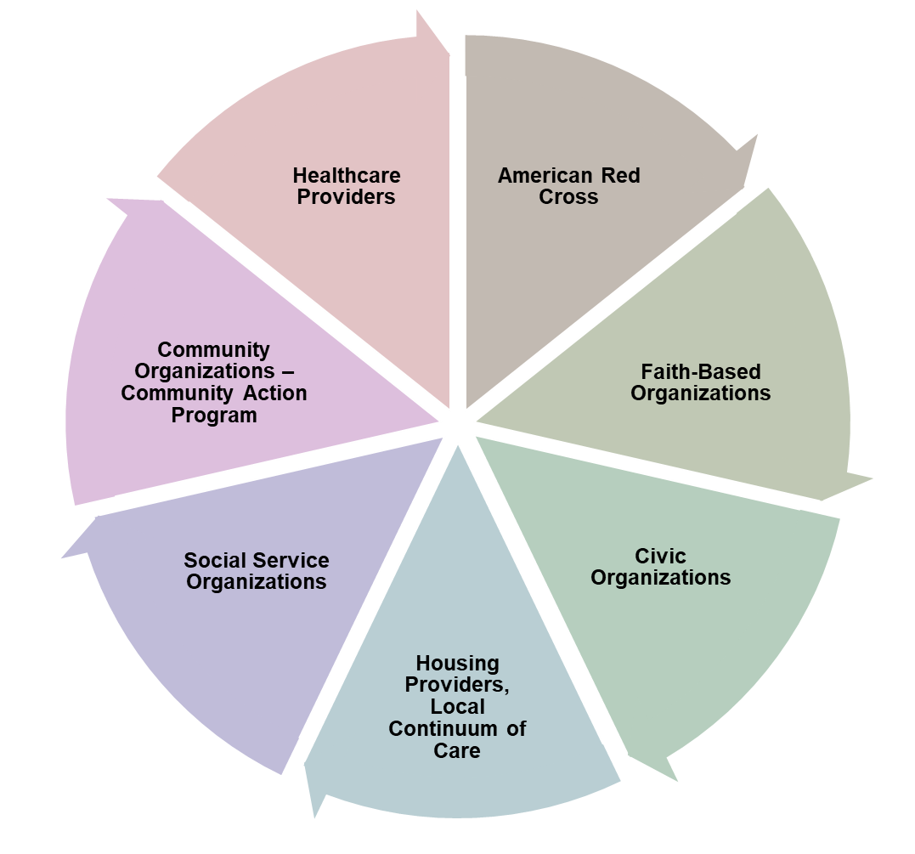
Non-Governmental Entities (NGOs)

Slide 18

Volunteer Organizations Active in Disaster (VOAD)
Formed in 1970 by 7 national disaster response organizations
70+ national NGO organizations
56 State/Territory VOADs
Share knowledge and coordinate resources (money, materials and muscle) throughout the disaster cycle (preparation, response, recovery)
National Voluntary Organizations Active in Disaster

Slide 19
Recovery Continuum Guided Principles
Individual and Family Empowerment
Leadership and Local Primacy
Engaged Partnerships
Unity of Effort
Timeliness and Flexibility
Resilience and Sustainability
Psychological and Emotional
National Disaster Recovery Framework, Second Edition (fema.gov)June 2016 Disaster
Recovery Framework Second Edition June 2016

Slide 20
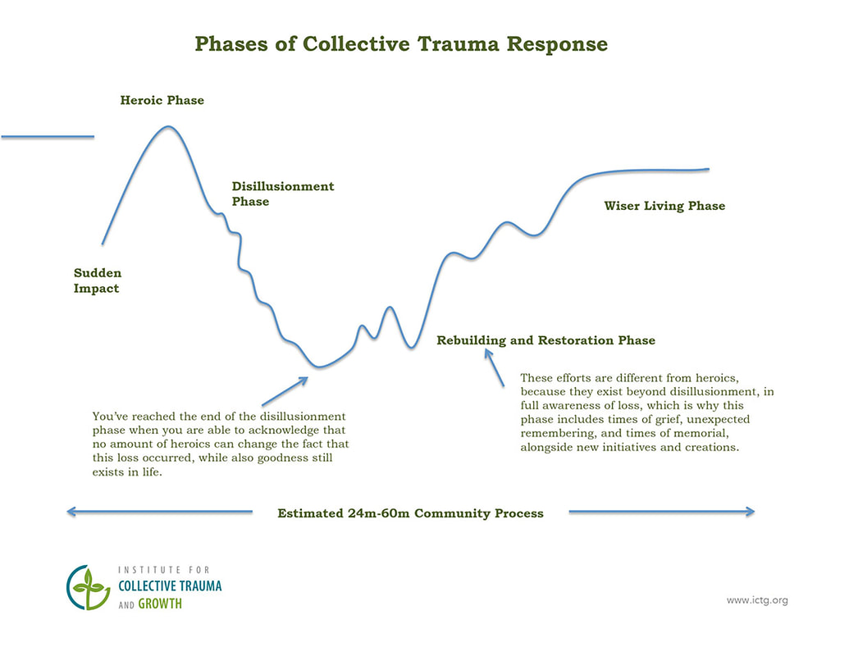


Phases of Collective Trauma Responses

Slide 21
Rural Factors that Impact Recovery
Risk Factors | Strengths
Low population density, large geographic area | Close knit communities and history of helping others
Limited broadband coverage | Generational history of resilience
Increased impact on employment- agriculture, forestry, mining | History and skills in resource sharing
Lower income and lack of resources
Stigma, fear of mental health and substance use services, lack of understanding and shame
Substance Abuse and Mental Health Services Administration: Rural Disaster Behavioral Health: A Guide for Outreach Workers and Crisis Counselors. Publication No. PEP23-01-01-002. MD: Center for Mental Health Services, Substance Abuse and Mental Health Services Administration, 2023

Slide 22

Crisis Counseling
FEMA and SAMHSA operate the Crisis Counseling Assistance and Training Program (CPP) which is available to states that then work with the local communities to implement CPP.
There are two types of CPP grants. The Immediate Services Program provides funds for up to 60 days after the Presidential Declaration of an Emergency. The Regular Services Program provides funding for up to 9 months.
Crisis Counseling includes
Helping disaster survivors understand their current situation and reactions
Reducing stress and providing emotional support
Assisting survivors in reviewing their disaster recovery options
Promoting the use or development of coping strategies
Connecting survivors with other people and agencies who can help them in their recovery process
SAMHSA Disaster Technical Assistance Center

Slide 23
Attention to the Children
Preschoolers | School Age Children | Adolescents
Distress and fear when parent is not present | Poor concentration and irritability | Withdrawal from family and friends
Return to earlier behaviors such as bed wetting | Clingy behavior with the parent- refusal to participate in events such as school | Sad, listless, preoccupation with the events of the disaster
Difficulty falling asleep | Sleep disturbances | Jumpiness and startles easily
Behavioral problems such as tantrums | Behavioral problems that are new for the child | Continual anxiety and fears about the even
 | Physical complaints such as stomach aches, head aches, dizziness for which there are no known physical causes
American Academy of Child and Adolescent Psychiatry – Disaster: Helping Children Cope

Slide 24
Talk about the event. Help children express their emotions.
Balance the discussion of the event with discussion of other activities.
Pay attention to the child. Show that you care.
Participate in games and events the child enjoys.
Limit media exposure.
Parents and influential adults model coping skills.
Be careful not to pressure to talk about the event.
Monitor the child for signs of increasing distress and seek professional help if concerned.
Helping Children and Youth Cope
SAMHSA Podcast- Helping Children and Youth Cope in the Aftermath of Disasters: Tips for Parents and Other Caregivers, Teachers, Administrators, and School Staff

Slide 25
Compassion Fatigue
Burn Out - Feeling exhausted and overwhelmed. Nothing you do will make a difference.
Secondary Traumatic Stress - Begin to internalize the trauma that has happened to others.
How to cope
Take care of yourself - good hygiene
Stay active
Talk to others
Participate in activities to support spiritual beliefs
Participate in coping activities and mindfulness
Tips for Disaster Responders: UNDERSTANDING COMPASSION FATIGUE

Slide 26

Submitting Questions and Comments
Submit questions by using the Q&A feature.
To open your Q&A window, click on the Q&A icon on the bottom center of your Zoom window.

Slide 27
Citations
Ørjasæter, K.B., Almvik, A. (2022). Challenges in Adopting Recovery-oriented Practices in Specialized Mental Health Care: “How Far Should Self-Determination Go; Should One be Allowed to Perish?”. J. Psychosoc. Rehabil. Ment. Health 9, 395–407.
Substance Abuse and Mental Health Services Administration (2000) Training Manual For Mental Health and Human Service Workers in Major Disasters.
UMCOR. (2013). Phases of Disaster Recovery: Emergency Response for the Long Term. Retrieved 9-7-2024
Institute of Collective Trauma and Growth. Phases of Disaster Response. Retrieved 9-7-2024.
NOAA. (2023). 2021 U.S. billion-dollar weather and climate disasters in historical context. 2021 U.S. billion-dollar weather and climate disasters in historical context | NOAA Climate.gov
Substance Abuse and Mental Health Services Administration (2023) Rural Disaster Behavioral Health: A Guide for Outreach Workers and Crisis Counselors. https://library.samhsa.gov/sites/default/files/pep23-01-01-002.pdf
Substance Abuse and Mental Health Services Administration (2024) Crisis Counseling and Assistance and Training Program. https://www.samhsa.gov/dtac/ccp retrieved 9-8-2024
American Academy of Child and Adolescent Psychiatry (2023) Disaster: Helping Children Cope. Retrieved 9-8-2024
Liu, J. SAMHSA Public Health Advisor (Host). Helping Children and Youth Cope in the Aftermath of Disasters: Tips for Parents and Other Caregivers, Teachers, Administrators, and School [Audio podcast episode]

Slide 28
Resources
FEMA (2019) National Response Framework. National Response Framework (fema.gov)
FEMA (2016). National Disaster Recovery Framework. National Disaster Recovery Framework, Second Edition (fema.gov)
FEMA. (2017). Pre-Disaster Recovery Planning Guide for Local Governments. Pre-Disaster Recovery Planning Guide for Local Governments (fema.gov)
FEMA (2019). National Response Framework Training Guide. fema_national-response-framework-training-guide_2019.pdf
Rural Health Information Hub. Rural Emergency Preparedness and Response. https://www.ruralhealthinfo.org/toolkits/emergency-preparedness/2/community-recovery#:~:text=The%20Recovery%20Continuum%20describes%20the,%2Dterm)%20after%20the%20disaster. Retrieved 8-5-2024

Slide 29
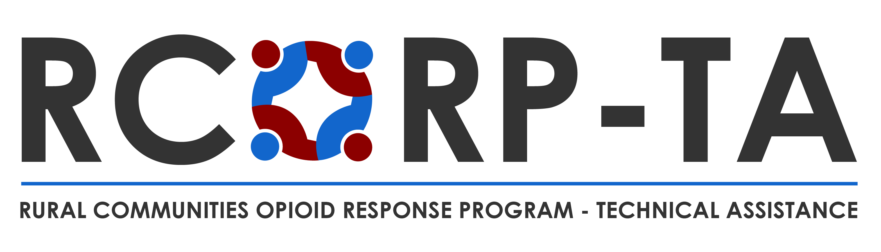
Thank you
The purpose of RCORP is to support treatment for and prevention of substance use disorder, including opioid use disorder, in rural counties at the highest risk for substance use disorder. Celeste Putnam, CPutnam@jbsinternational.com
Ann Wing, awing@jbsinternational.com
Karen Yost, KYost@jbsinternational.com

